Slide 1
Course - DT228-2
Module (Subject) -
Human Computer Interaction
Semester 2, Week 4
DESIGN (Process)

Slide 2
Overview
Life-Cycle Models in Human Computer Interfaces
Four basic activities in HCI
Requirements
Design
Develop/Build
Evaluation

Slide 3
Interaction Design Basics
Design:
What it is, interventions, goals, constraints
The design process
What happens during design
Users
Who they are, what they are like…
Scenarios
‘Rich stories’ of design
Navigation
Finding your way around a system
Iteration and prototypes
You never get it right first time!
Design Principles

Slide 4
Interactions and Interventions
Design interactions - not just interfaces
Not just the immediate interaction
E.G. a stapler in an office – technology changes the interaction style:
manual: write, print, staple, write, print, staple, …
electric: write, print, write, print, …, staple
Designing interventions - not just artefacts
Not just the system, but also…
documentation, manuals, tutorials
What we say and do, as well as what we make.
Design Principles

Slide 5
What is Design?
Achieving goals within constraints
Goals - purpose
Who is it for? Why do they want it?
Constraints
Materials, platforms
Trade-offs
Some things (system features) need to be left out
Design Principles

Slide 6
Design for Human Computer Interaction
The golden rule of design: understand your materials
Understand computers, and their:
limitations, capacities, tools, platforms
Understand people – their:
psychological, social aspects
human errors
and their interaction…
Design Principles

Slide 7
Design and Human Error
Accident reports...
Aircrash, Industrial Accident, Hospital Mistakes…
Enquiry… blames… ‘human error’
But… if a concrete lintel breaks because too much weight in a wall, do we blame ‘lintel error’? …No – this is a design error. We know how concrete behaves under stress.
Human ‘error’ is normal.
We know how users behave under stress…
…so design for it!
Treat the user at least as well as physical materials.
Design Principles

Slide 8
The Process of Design
Scenarios Task Analysis
What is wanted
Guidelines
Principles
Analysis
Interviews
Ethnography
What is There
vs.
What is Wanted
Precise Specification
Design
Dialogue Notations
Implement
and Deploy
Evaluation
Heuristics
prototype
Architectures
Documentation
Help
Design Principles

Slide 9
Steps in Design
Requirements
What is there and what is wanted
Analysis
Placing in order, getting an understanding
Design
What to do, and how to decide on options
Iteration and Prototyping
Getting the design right… Finding what is really needed!
Implementation and Deployment
Making the system, and getting it out there
Design Principles

Slide 10
Project Constraints and Limitations
With limited time on a project, there may need to be design ‘trade-offs’.
Usability?
Finding problems (throughout) and fixing them, if required.
… Deciding what to fix (!?)
A perfect system might be badly designed
If a system is ‘too good’, maybe there was too much effort in design.
Design Principles

Slide 11
Life Cycle Models
Life Cycle Models structure the software development life of a product.
They show how activities are related to each other.
They can be regarded as management tools.
Life-Cycle Models

Slide 12
A Simple Interaction Design Model
Identify needs/
establish
requirements
(Re)Design
Evaluate
Build an
interactive
version
Exemplifies a user-centered design approach
Final Product
Life-Cycle Models

Slide 13
A Traditional Waterfall Model
Requirements analysis
Design
Code
Test
Maintenance
Life-Cycle Models

Slide 14
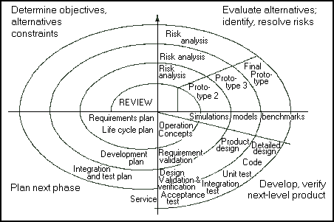
A Spiral Life Cycle Model
From cctr.umkc.edu/~kennethjuwng/spiral.htm
Life-Cycle Models

Slide 15
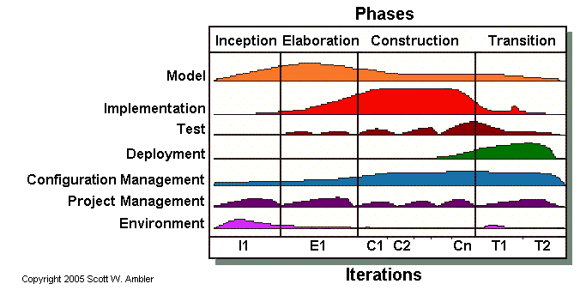
Agile Unified Process
Life-Cycle Models

Slide 16
The Star Life Cycle Model
Suggested by Hartson and Hix (1989)
Important features:
Evaluation at the centre of activities
No particular ordering of activities. Development may start in any one
Models are derived from empirical studies of interface designers
Life-Cycle Models

Slide 17
The Star Life Cycle Model
(Hartson and Hix (1989)
Implementation
Task/Functional
Analysis
Prototyping
Evaluation
Requirements
Specification
Conceptual/
Formal Design
Life-Cycle Models
Notes:
User Centred Design is a very general philosophy that instantiates itself in the context of a design project. Within HCI there have been many attempts to come up with actual life cycles where users are central. Examples include Rubinstein and Hersch successive iteration of 5 stages, info collection, design, implementation, evaluation and deployment. The one here is taken from Hartson and Hix model came about by analysing how design takes place in practice evaluation is central: results of each activity are evaluated before going onto next one both bottom-up and top -down required in waves software designers are familiar with this in their work and call it ‘yo-yoing’
it is important to do both structure and detail at the same time
in practice this is what is done - but the end result suggests otherwise corporate requirements dictate a top=down approach which is what gets recorded
Chapter 5 of Developing User Interfaces (An Overview of Systems Analysis and Design) p- nice step-by-step methodology for doing user-centred design

Slide 18
Design Model
Requirements
Design
Build/Develop
Evaluate
Life-Cycle Models

Slide 19
Requirements (Back to…)
A requirement is something the product must do, or a quality that the product must have.
Requirements

Slide 20
Requirements (2)
Different kinds of requirements:
Functional:
What the system should do
Historically the main focus of requirements activities
Non-functional:
memory size,
response time…
…continued
Requirements

Slide 21
Requirements (3)
Different kinds of requirements continued:
Usability:
learnability
throughput
flexibility
attitude
Requirements

Slide 22
Consider this…
What are the requirements for Webcourses? You could:
draw a use-case diagram to illustrate the functional requirements.
write down a list of at least three non-functional requirements.
write down a list of at least three usability requirements.
Requirements

Slide 23
Requirements (4)
Determining Usability Requirements:
Task Analysis
User Analysis
Environment Analysis
Requirements

Slide 24
Requirements – Task Analysis
Who is going to use the system?
What tasks do they now perform?
What tasks are desired?
How are the tasks learned?
Where are the tasks performed?
What is the relationship between user and data?
Requirements

Slide 25
Requirements – User Analysis
Who are they?
System use: novice, expert, casual, frequent
Culture step-by-step (prompted), constrained, clear information
Disability: cognitive, physical
Age: child, young adult, ageing user...
Requirements

Slide 26
Requirements – Environmental Analysis
Physical: Dusty? Noisy? Vibration? Light? Heat? Humidity?...
Social: Sharing of files, of displays, on paper, across great distances, work individually, privacy for clients.
Organisational: Hierarchy, IT department’s attitude and remit, user support, communications structure and infrastructure, availability of training.
Requirements

Slide 27
Design Model
Requirements
Design
Build/Develop
Evaluate
Life-Cycle Models

Slide 28
Design Model
Requirements
Design
User-centred design
Build/Develop
Evaluate
Life-Cycle Models

Slide 29
Users’ Involvement in Design
Know your user
Personae (plural of ‘persona’)
Cultural investigation
User-Centred Design

Slide 30
Know Your User
Who are they?
They are probably not like you!
Talk to them,
watch them,
use your imagination…
User-Centred Design

Slide 31
Personae
Form a description of an ‘example’ user.
Not necessarily a real person
Use this as surrogate user.
“What would Betty think?”
Details matter (They make her ‘real’)
User-Centred Design

Slide 32
Example Persona
Betty is 37 years old. She has been Warehouse Manager for five years, and worked for Simpson Brothers Engineering for twelve years. She did not go to university, but has studied on evening classes for a business diploma. She has two children aged 15 and 11, and does not like to work late. She did part of an introductory in-house computer course some years ago, but it was interrupted when she was promoted and could no longer afford the time to study. Her vision is perfect, but her right-hand movement is slightly restricted following an industrial accident 3 years ago. She is enthusiastic about her work and is happy to delegate responsibility and take suggestions from her staff. However, she does feel threatened by the introduction of yet another new computer system (- the third in her time at Simpson Brothers Eng.)
User-Centred Design

Slide 33
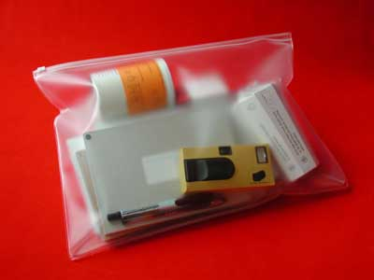
Cultural Investigation
Example: direct observation
Sometimes this is difficult. (Think of users in the home, shift work employees, hospital patients…)
Investigation packs (Items to prompt responses)
E.G. Notepad and pen, camera, postcards…)
Might be given to people to open in their own environment. They record what is meaningful to them.
Used to…
inform interviews, prompt ideas, enculture designers.
User-Centred Design

Slide 34
Why Involve Users?
Expectation management
Realistic expectations
No surprises, no disappointments
Timely training
Communication - but no hype
Ownership
Make the users active stakeholders
They might be more likely to forgive or accept problems
They can make a big difference to acceptance and success of the product
User-Centred Design

Slide 35
What is a Users-Centred Approach?
Early focus on users and tasks: directly studying cognitive, behavioural, anthropomorphic and attitudinal characteristics.
Empirical measurement: users’ reactions and performance to scenarios, manuals, simulations and prototypes are observed, recorded and analysed.
Iterative design: when problems are found in user testing, fix them and carry out more tests.
User-Centred Design

Slide 36
Ethnographic Observation
Preparation
Understand the organisation’s policies and work culture.
Familiarise yourself with the system and its history.
Set initial goals and prepare questions.
Gain access and permission to observe/interview users.
Field Study
Establish rapport with managers and users.
Observe/interview users in their workplace and collect subjective/objective quantitative/qualitative data.
Follow any leads that emerge from the visits
User-Centred Design

Slide 37
Ethnographic Observation (2)
Analysis
Compile the collected data in numerical, textual, and multimedia databases.
Quantify data and compile statistics.
Reduce and interpret the data.
Refine the goals and the process used.
Reporting
Consider multiple audiences and goals.
Prepare a report and present the findings.
User-Centred Design

Slide 38
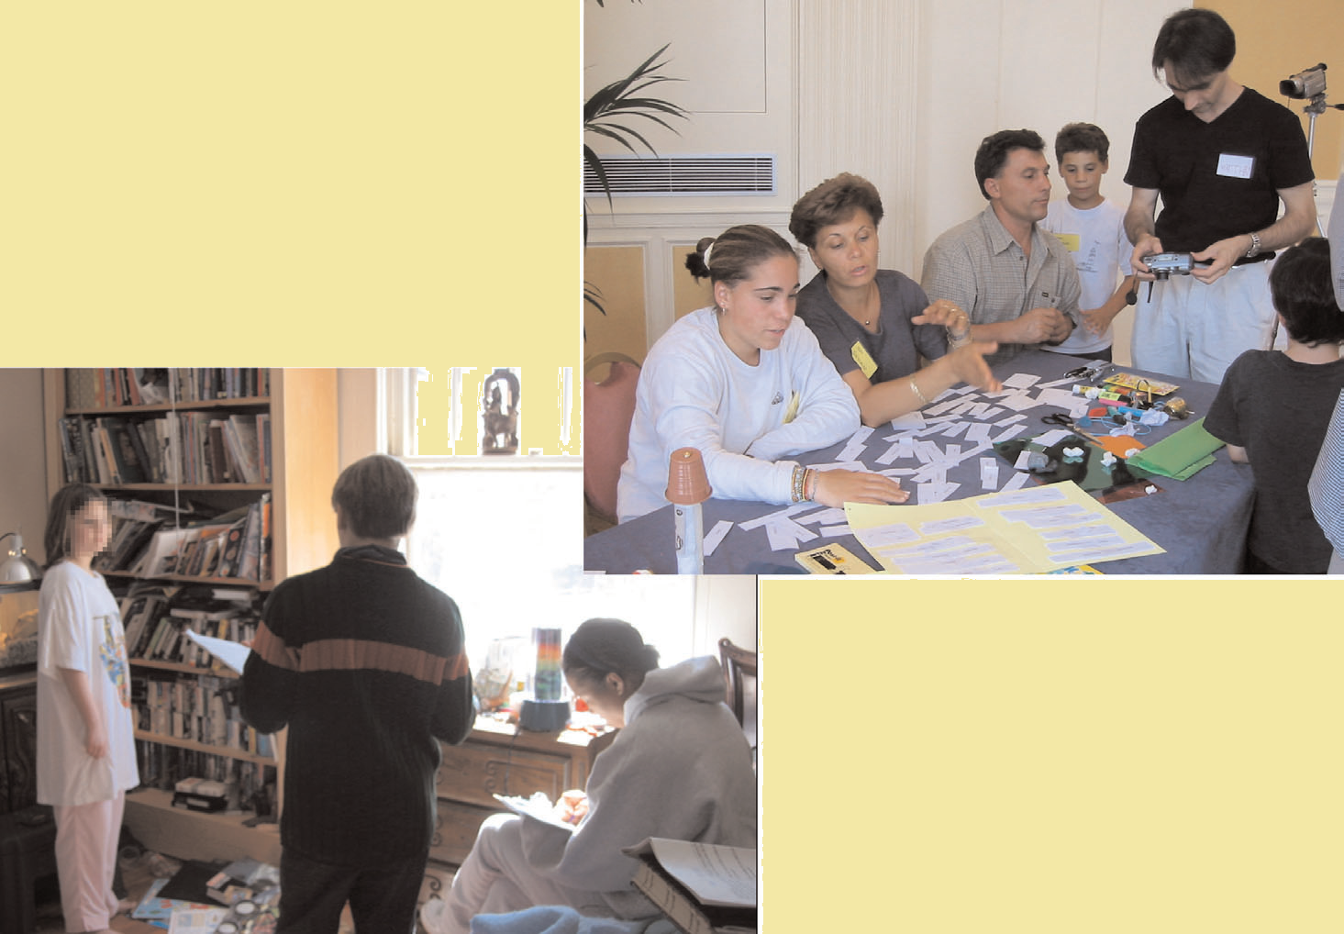
Participatory Design
User-Centred Design

Slide 39
Participatory Design (2)
Participatory (or Participative) Design
This is an approach to design that attempts to actively involve the end users in the design process.
It assumes that users should play an active role in the creative process: users envision the future by identifying the defining moments from their perspective.
User-Centred Design

Slide 40
Participatory Design (3)
Controversial
More user involvement brings:
more accurate information about tasks
more opportunity for users to influence design decisions
a sense of participation that builds users' ego investment in successful implementation
potential for increased user acceptance of final system
User-Centred Design

Slide 41
Participatory Design (4)
However, extensive user involvement may:
be more costly
lengthen the implementation period
build antagonism with people not involved or whose suggestions rejected
force designers to compromise their design to satisfy incompetent participants
build opposition to implementation
exacerbate personality conflicts between design-team members and users
show that organisational politics and preferences of certain individuals are more important than technical issues
User-Centred Design

Slide 42
Participatory Design (5)
PICTIVE
Plastic Interface for Collaborative Technology Initiatives through Video Exploration .
This method is intended to empower users to act as full participants in design.
User-Centred Design

Slide 43
Participatory Design (6)
PICTIVE
Equipment required:
Shared design surface, e.g. a table
Video recording equipment
User-Centred Design

Slide 44
Participatory Design (7)
Before a PICTIVE session:
Users generate scenarios of use.
Developers produce design elements for the design session.
A PICTIVE session has four parts:
Stakeholders all introduce themselves.
Brief tutorials about areas represented in the session (optional).
Brainstorming of ideas for the design.
Walkthrough of the design and summary of decisions made.
User-Centred Design

Slide 45
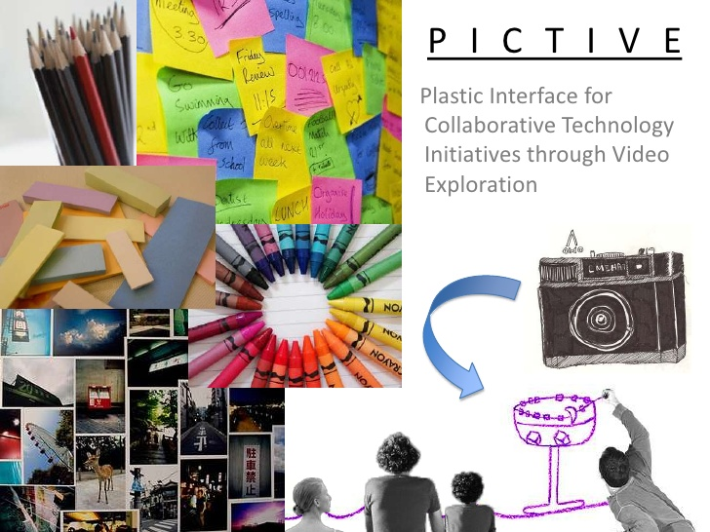

Slide 46
Participatory Design (8)
CARD
Collaborative Analysis of Requirements and Design
Similar to PICTIVE, but at a higher level of abstraction: explores work flow not detailed screen design.
Uses playing cards with pictures of computers and screen dumps.
Similar structure to the session as for PICTIVE.
PICTIVE and CARD can be used together to give complementary views of a design.
User-Centred Design

Slide 47
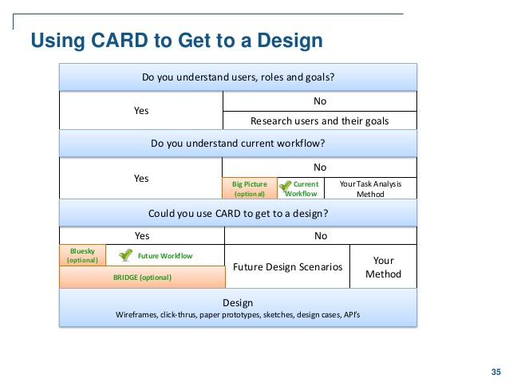

Slide 48
Scenarios
Stories for design
Communicate with others in the project
Validate other design models
Understand the design dynamics
Linearity
Time is linear - our working lives are linear
But linearity does not show alternatives (in they way it is normally presented)
User-Centred Design

Slide 49
Scenarios
What will users want to do?
Use a step-by-step walkthrough
What can they see? (Sketches, screen shots)
What do they do? (Keyboard, mouse, etc.)
What are they thinking?
Use and reuse this study throughout design
User-Centred Design

Slide 50
Example Scenario – Movie Player
Brian would like to see the new film, “Moments of Significance”, and wants to invite Alison, but he knows she doesn’t like “Arthouse” films. He decides to take a look at it to see if she would like it, so connects to Amazon Prime. He uses his work computer and network as it has a higher bandwidth connection, but feels a bit guilty. He knows he will be taking a copy of the film, but decides it is OK as he is intending to go to the cinema to watch it. After it downloads to his work computer he opens his new personal movie player app on his own laptop. He presses the ‘Menu’ button and on the laptop screen he scrolls using the arrow keys to ‘Bluetooth Connect’ and presses the select button. On his laptop the movie download program now has an icon showing that it has recognised a compatible device and he drags the icon of the film over the icon for the player. On the laptop the screen says “Downloading now”, a ‘percent done’ indicator and small whirling icon … … …
User-Centred Design

Slide 51
Explore with Scenarios
Explore interaction
What happens when…
Explore cognition
What are the users thinking?
Explore architecture
What is happening inside the system?
User-Centred Design

Slide 52
Explore with Scenarios (2)
Use scenarios to:
communicate with others - designers, clients, users
validate other models
‘Play’ it against other models
express dynamics
Screenshots – for appearance
Scenario – for behaviour
User-Centred Design

Slide 53
Linearity
Scenarios – one linear path through a system
Pros:
Life and time are linear
Easy to understand (stories and narrative are natural)
Concrete (errors less likely)
Cons:
No choice, no branches, no special conditions
Miss the unintended
So use several scenarios, use several methods
User-Centred Design

Slide 54
Summary of the Lecture
Lifecycle Models
Software engineering lifecycle models
HCI lifecycle models
Usability Engineering Lifecycle Model
Star Lifecycle Model
HCI Design Models
Requirements
Design
User-Centred Design
Develop/Build
Evaluation

Slide 55
References
Preece, J. et al. (2002) Interaction Design
Shneiderman, B. & Plaisant, C. (2005) Designing the User Interface
Benyon, D. et al (2005) Designing Interactive Systems
Helander, M. et al (1997) Handbook of Human-Computer Interaction
Hartson, R. & Hix, D. (1989) Towards Empirically Derived Methodologies and Tools for HCI Development
Mayhew, D. (1995) The Usability Engineering Lifecycle
Alan Dix et al (1993) Human Computer Interaction
References

